Slide 1
Real Estate Concepts

Slide 2

What is Real Estate?
Real estate is a legal term that began in England to identify royal grants of estate land.
The word “real” is derived from Latin, meaning existing, actual, or genuine.
Real estate refers to tangible or physical land and improvements attached to the land

Slide 3
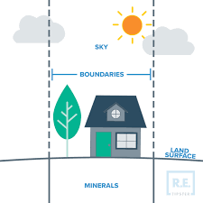
Real Estate is more than land
Land
  Earth’s surface
  Below the surface to the center of earth
  Sky to infinity
Attachments by nature
  Boulders
  Trees
  Water
  Minerals
Artificial attachments (improvements)
  Buildings
  Fences
  Crops
Real Estate + Rights of Ownership = Real Property

Slide 4

Characteristics of Land
Physical:
  Location (Immobility)
  Indestructible
  Non-Homogeneity
  Non-Fungible (not interchangeable)
Economic:
  Scarcity
  Location (situs)
  Improvements (durability)

Slide 5
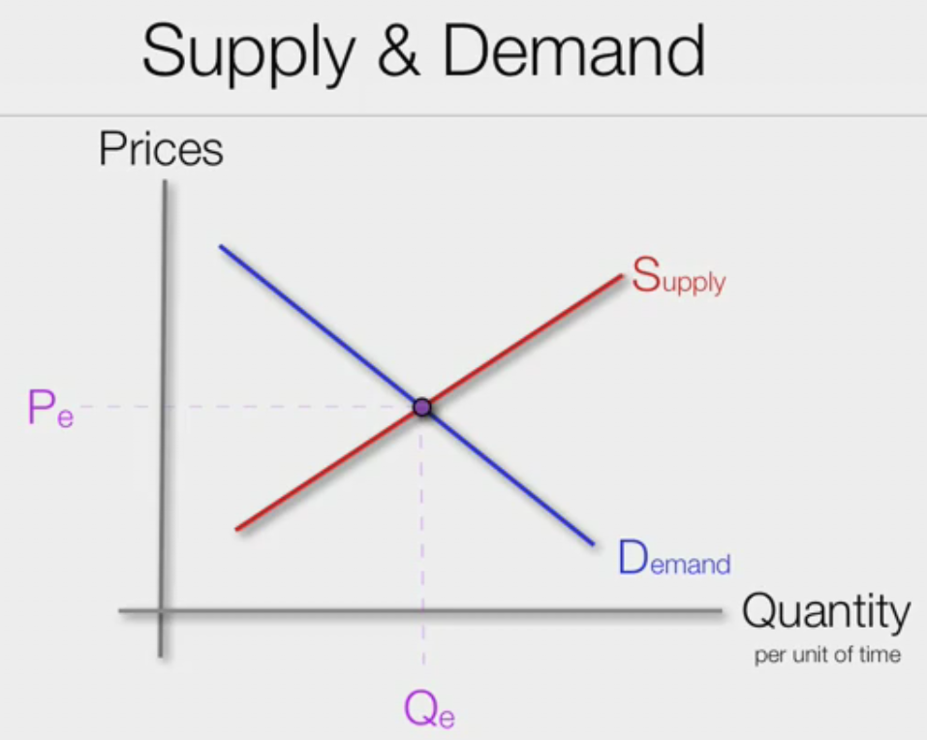
Economic Definitions
(source: Investopedia)
Economics
  Social science of how to allocate resources
Scarcity
  Limited resources and unlimited wants
Economy
  Interrelated production and consumption of resources
Supply
  How much is available to sell
Demand
  How much is desired to purchase

Slide 6
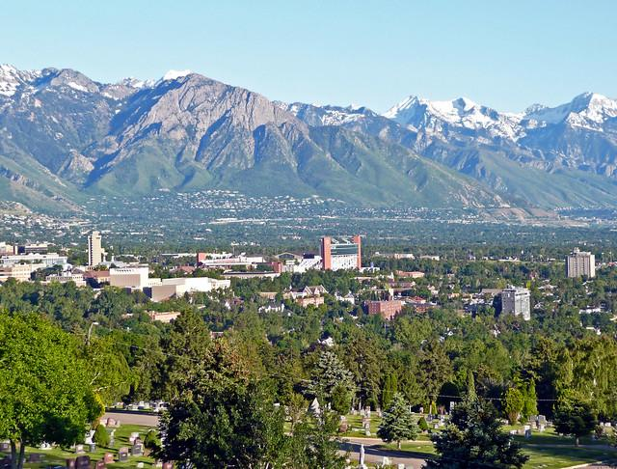
Scarcity
Less than 30% of earth is land
About 12% is considered habitable
Difficult to find unimproved land in some areas
Supply & Demand:
  Low supply + high demand = high price
  High supply + low demand = low price

Slide 7
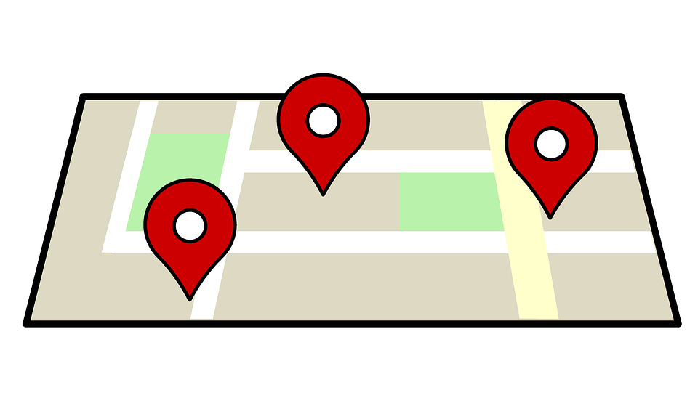
Location
Also called Situs
  Defined by legal description
Value is affected by location
  Supply & Demand
Affected by personal preferences

Slide 8
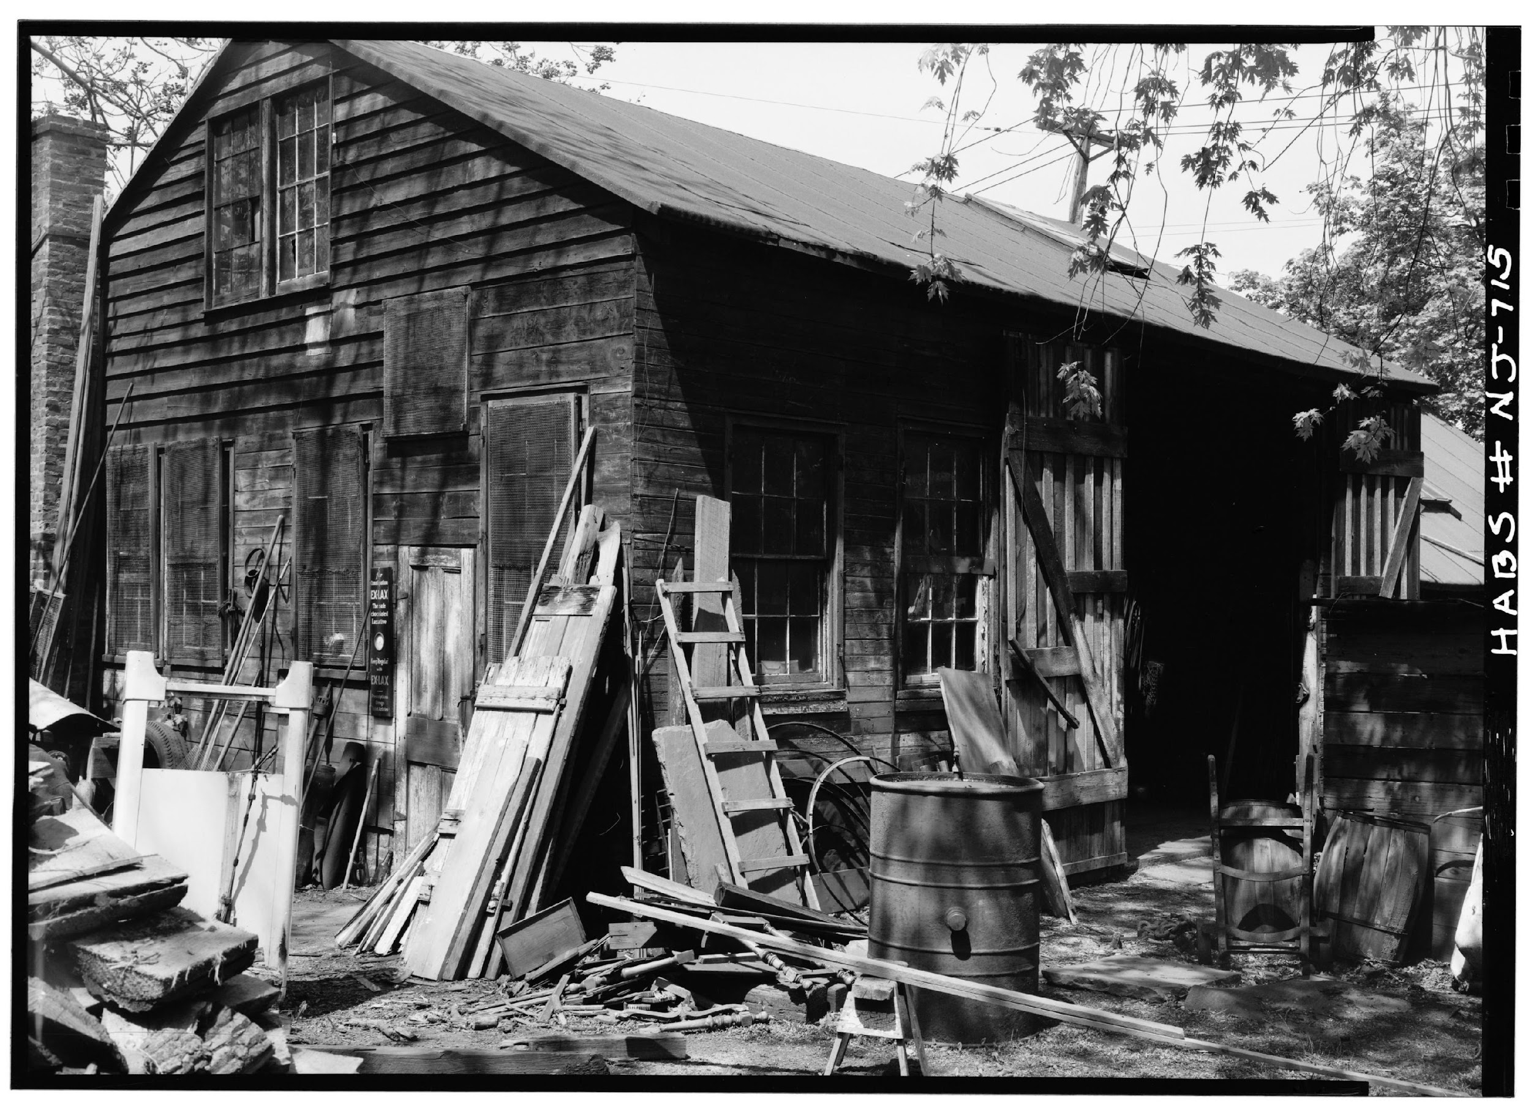
Improvements
Durability
  Adds to a lasting or increased value
Appurtenant:
  Attached to the land (building, fence)
Emblement:
  Crops:
    Planted tree is appurtenant
    Harvested fruit is emblement

Slide 9
How does real estate impact the economy?
65% of American families own their own primary residence (source: Federal Reserve)
Real estate represents a significant portion of most people’s wealth
When home prices rise:
  Individuals and businesses are more likely to borrow and spend
  Ripple effect on economy with jobs
Commercial real estate create jobs and spaces for retail, office, and manufacturing
Real estate investment is source of revenue (income)
Great Recession of 2008
  Real estate values dropped
  Banks failed
  25% unemployment

Slide 10
Test Yourself - 1
Your name :
Question
Answer
What is another name for improvements?
Give 3 examples of improvements
What is economics?
What is scarcity?
How does it apply to real estate?

Slide 11
Test Yourself - 2
Question
Answer
Define the word Economy
What is Supply and Demand?
How does this affect real estate?
What is another name for Location?
Why is location important in real estate?

Slide 12
Test Yourself - 3
Question
Answer
Compose a paragraph about how real estate is important to our economy (at least 5 sentences).
You may use other resources than this presentation

